Slide 1

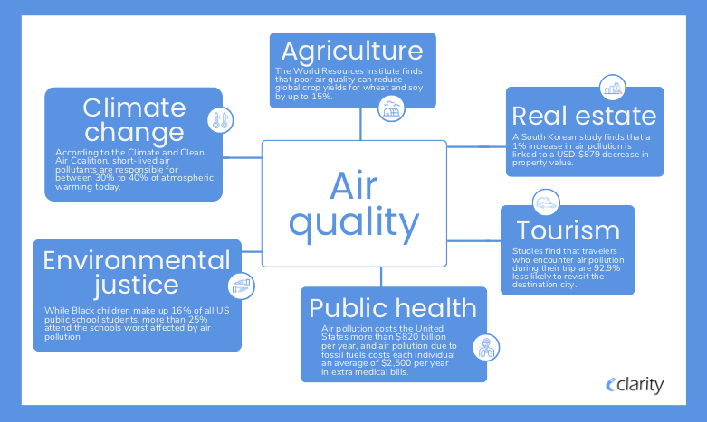
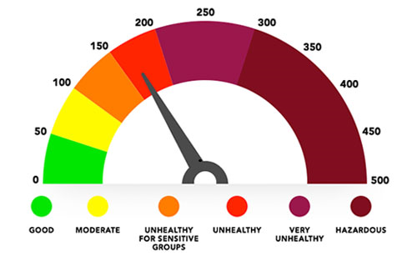
AIR QUALITY

Slide 2

OBJECTIVE
The objective of the air quality index is to provide a simple and standardized way to communicate information about air quality to the public.

Slide 3
Importance of aQI
The importance of AQI lies in its direct and profound impact on HUMAN HEALTH, THE ENVIRONMENT , AND OVERALL QUALITY OF LIFE.
Maintaining good air quality is crucial for safeguarding human health , preserving ecosystems, supporting economic well being and ensuring a sustainable and livable planet.

Slide 4
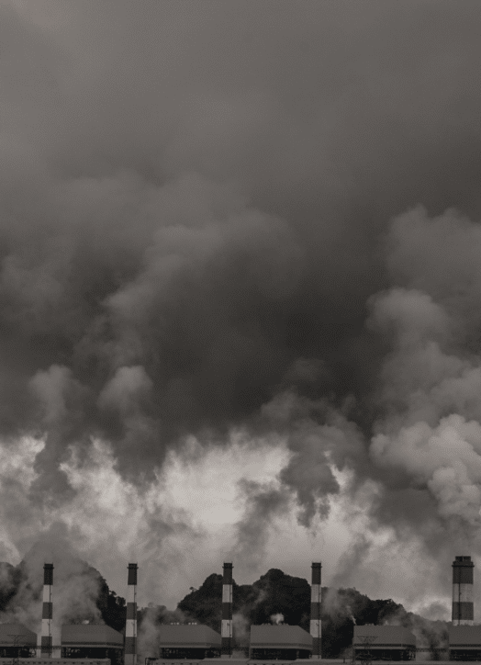
FACTORS AFFECTING AIR QUALITY
SOURCE OF AIR POLLUTION:
BURNING OF FOSSIL FUELS.
OZONE AND SMOG.
WEATHER CONDITIONS.
HEATWAVES AND WILDFIRES.

Slide 5
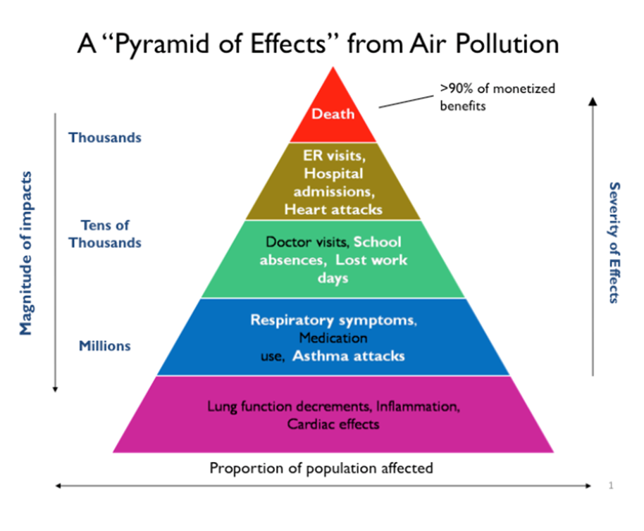
EFFECTS OF AIR POLLUTION
Air pollution contributes to the death of 5 million every year and about 6% of the global population, according to Our World in Data.
The environmental effects of air pollution are also vast, ranging from acid rain to contributing to birth defects, reproductive failure, and diseases in wildlife animals.

Slide 7
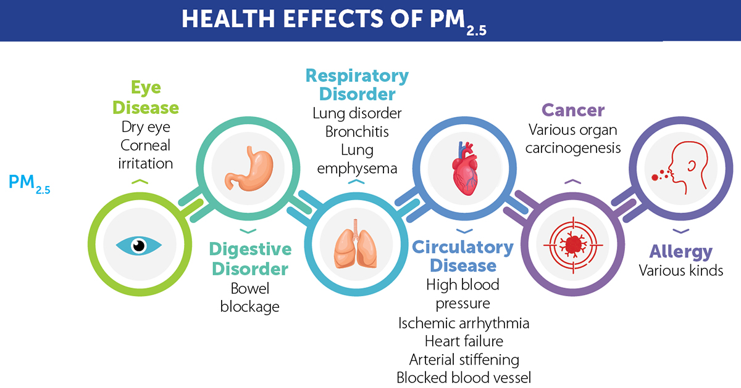
Health impacts
Air pollution can affect lung development stroke, chronic obstructive pulmonary disease, trachea, bronchus and lung cancers, aggravated asthma and lower respiratory infections.

Slide 8
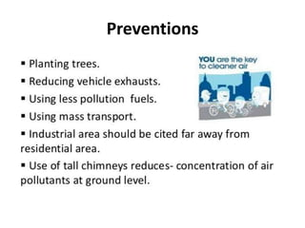
PREVENTIVE MEASURES

Slide 9
PRESENTED BY
Shafeeqah Parveen S
Rohini S
Mohammed Rafiq A
Narendra K

